Slide 1

Travel Guide

Slide 2
Name :- Harishchandra Bansode.
Roll No:- 12038.
Project Name :- Travel Guide.

Slide 3
Introduction
Build and deploy an advanced Travel Companion Application using Google Maps. With Geolocation, Google Maps API, searching for places, fetching restaurants, hotels and attractions based on location from specialized Rapid APIs, data filtering and much more, this Travel Guide App is the best Maps Application that you can currently find on the internet.

Slide 4
Technology & Features used
Google Map API
Travel Advisor API
Rapid API
React.js
HTML ,JavaScript, CSS.

Slide 5
I/O Screen

Slide 6
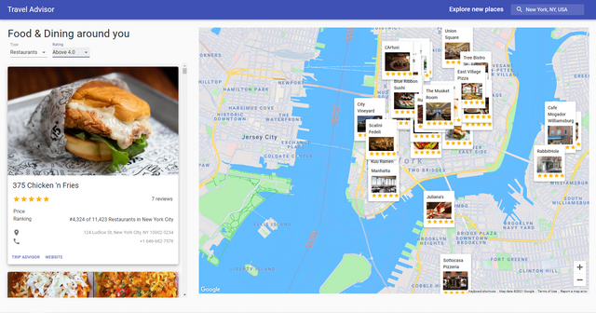

Slide 7
Future Enhancement
Develop android app
Can work better with unstable internet connection
Make compatible with other browsers
Show Additional information about particular location.
Show Weather Information about particular Place.

Slide 8
Conclusion
The Travel Advisor is used to give a better travel experience for the end user. The application solves the needs of user. without troubling them as existing applications do: it uses technology to increase the interaction of the system with the user in many ways. It eases the work of the end-user by fetching information about hotels, restaurant, popular places.

Slide 9


